Slide 1
ChIP-seq analysis of the NR4A nuclear receptor transcription factor in C. elegans
Chris R. Gissendanner, Ph.D.
Dept. of Basic Pharmaceutical Sciences
ULM College of Pharmacy

Slide 2
Project Background
Focus of INBRE project is to determine the cellular mechanisms of NR4A NR activity during organogenesis in C. elegans
NHR-6 is the C. elegans NR4A nuclear receptor ortholog
Hypothesis: NHR-6 has dualistic functions in regulating cell proliferation and cell differentiation and that these activities are regulated through differential interactions with signal transduction pathways
One test of this hypothesis is to identify NHR-6 target genes
What are the target genes regulated by NHR-6 during distinct stages of organ development?
Are there distinct sets of target genes regulated by NHR-6 during the cell proliferation and cell differentiation stages of organ development?

Slide 3
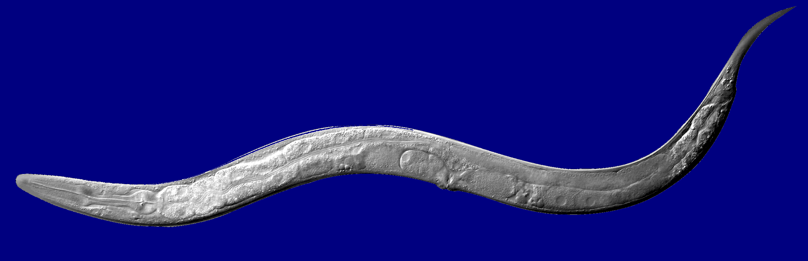
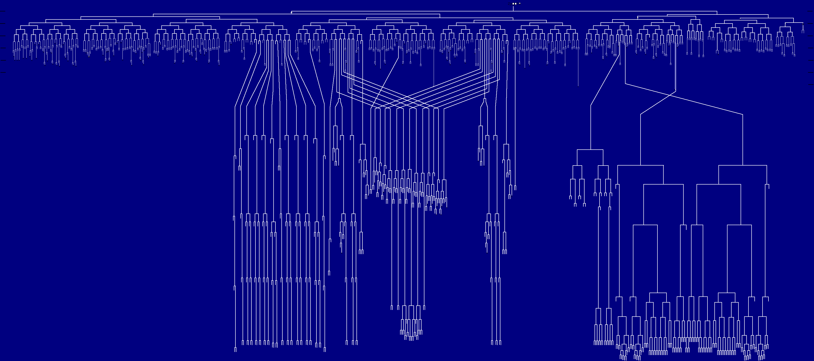
Caenorhabditis elegans: invariant cell lineage
Notes:
3

Slide 4
ChIP-seq: rationale and approach
ChIP-seq is a robust, unbiased approach to identifying candidate transcription factor target genes
Our experimental system is also well-suited to using this approach
1) NHR-6 is not broadly expressed (restricted to a specific organ primordium and a few neurons) → for our whole-animal approach most target genes will have relevance to the developmental process we are studying
2) We have shown that GFP-tagged NHR-6 is fully functional in vivo using genetic rescue assays
Reliable GFP antibodies
3) Concurrent study using microarray analysis of tissue-specific isolated mRNAs
Correlate ChIP-seq data to gene expression data

Slide 5
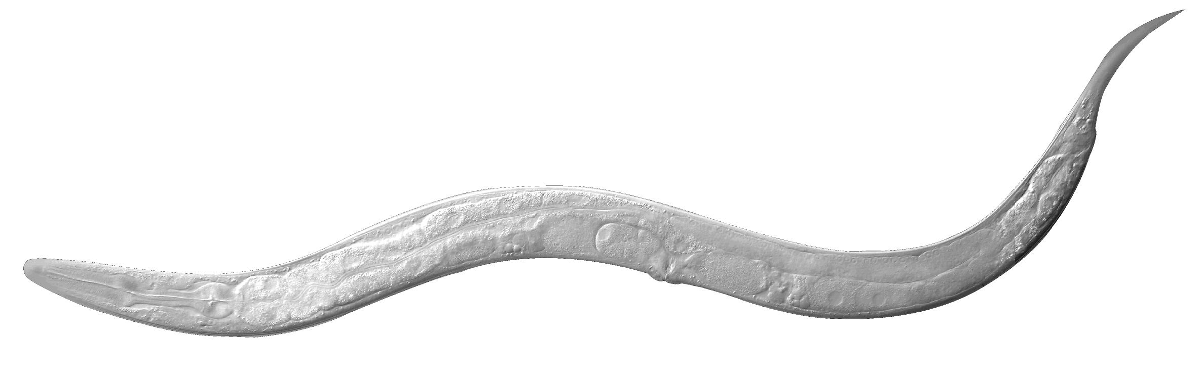
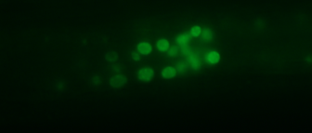
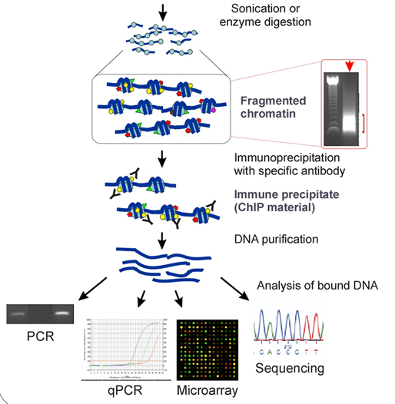
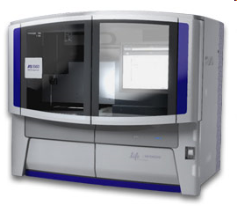
Experimental Approach: Whole animal ChIP-seq
Cross-link NHR-6::GFP to DNA in vivo
animal lysis
Next-Generation Sequencing followed by bioinformatic analyses

Slide 6
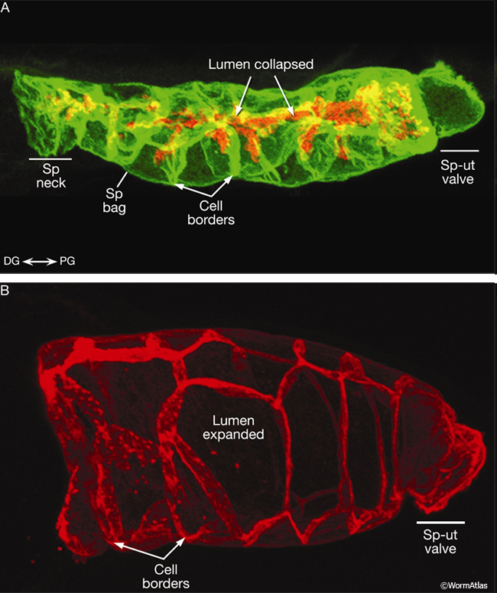
Spermatheca organ system

Slide 7
Plan
Optimize ChIP conditions (sonication and IP)
Time course experiment → two developmental stages
Late L3/early L4 and mid/late L4 stages
8-sample run: sequence two biological replicate IP DNAs at each stage plus input for each replicate
Sequence ChIP DNA at Pennington Genomics Core Facility (SOLiD system)
Collaborate with Dr. Joohyun Kim at LSU CCT (INBRE Bioinformatics Core) for computational analysis

Slide 8
Collaboration with LSU CCT
Analysis of ChIP-seq data
1) Sequence reads need to be mapped to a reference genome
2) Peak calling algorithms utilized to identify peak regions at different levels of statistical significance
3) Downstream analysis: gene calls, motif search, gene ontology

Slide 9
Collaboration progress to date
Analysis of modEncode data
Data for NHR-6 available for public download
Raw data fastq files
C-terminal GFP fusion
L2 stage (NOT the developmental stage of interest)
Illumina sequencing followed by ELAND mapping and Peakseq peak calling algorithm
Data set we could use immediately to test mapping programs and peak calling algorithms
Compare peak calling results to modEncode Peakseq results
Comparison of data at two developmental stages (one stage when the organ formation process is occurring and the other when it is not)

Slide 10
Collaboration progress to date
M.S. student Rashika Rangaraj performed an INBRE summer research project with Dr. Kim
Developed an initial analysis pipeline of the modEncode data
mapping, peak calling (MACS), and visualization with UCSC Genome Browser
MACS vs. Peakseq comparisons
MEME analysis on MACS and Peakseq peaks

Slide 11
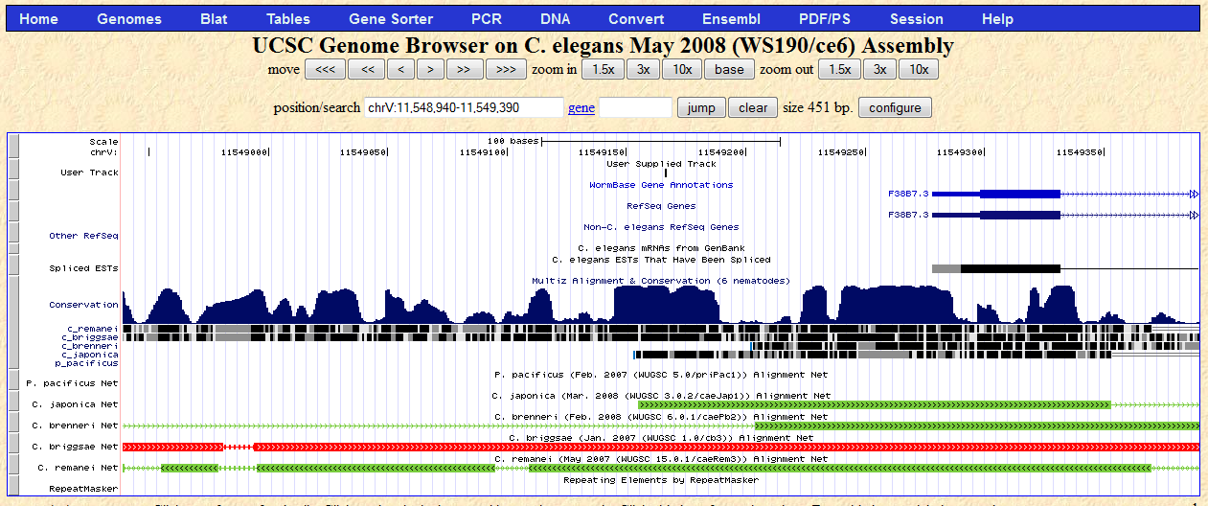
The Red arrow indicates the location of the summit of the MACS peak : Chr V: 11548940-11549390

Slide 12
Some things we have learned…
Different mapping and peak calling algorithms give different results
# of peaks called; peak boundaries
The latter can be critical in running downstream analyses (e.g. MEME)
Multiple mapping and peak calling algorithms likely to be useful
Sequencing platforms (SOLiD and Illumina) have analysis pipelines (LifeScope is the pipeline for SOLiD)
DARE will provide options for additional mapping and peak calling in addition to the platform pipeline

Slide 13
Comparing # MACS peaks for Chromosomes I - V
with FDR≤ 40%
Total # MACS peaks: BWA= 56, Bowtie= 57
FDR% | BWA | Bowtie
0 | 8 | 7
0-5 | 6 | 1
5-10 | 5 | 2
10-20 | 5 | 10
20-40 | 32 | 37
# MACS peaks
FDR %

Slide 14
Comparing MACS Peaks for Chromosomes I- V with FDR ≤ 40% from BWA and Bowtie
6 sequences unique to BWA ( not present in Bowtie)
7 sequences unique to Bowtie ( not present in BWA)
8 sequences have differing summit values called by BWA and Bowtie
# new summit values in Bowtie w.r.t BWA = 15 ( out of a total of 57)
All summit value differences lie between 20 bp to 100 bp except two summit peaks:
1. chromosome II: summit difference =220 bp
2. chromosome III: summit difference= 4031 bp

Slide 15
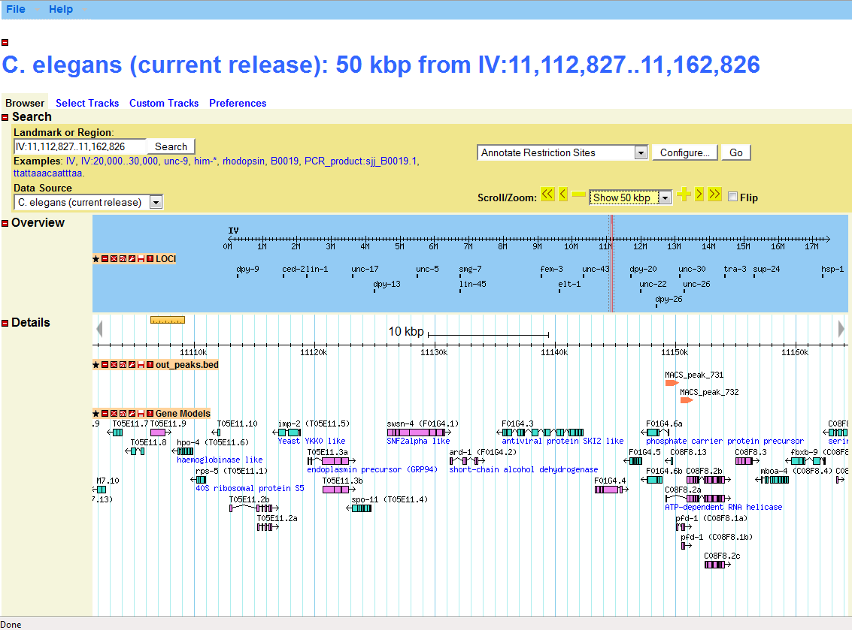
Wormbase C. elegans browser with uploaded MACS output file (from DARE)

Slide 16
Some Issues
MEME analysis of highly significant peaks from MACS and Peakseq (provided by modEncode) did not uncover the NR4A NR canonical site
NHR-6 may have unexpected binding properties (although no significant motifs were found within the peak sequences)
Incorrect peak boundaries
Develop other approaches → search peak sequences with TF binding site databases
Could this type of function be incorporated into DARE?

Slide 17
Current situation with NHR-6 project
Optimize sonication/DNA isolation procedures to generate appropriate fragment lengths for SOLiD (~250 bp)
We have been successful at anti-GFP IP and we get more DNA from our IP than we do from identically treated non-transgenic controls
Working towards tissue-specific gene expression studies (WT vs. mutant)

Slide 18
Acknowledgements
Rashika Rangaraj
Jeremy Harmson
Dr. Joohyun Kim
Dr. Brian Rowan (Mentor)
Funding by INBRE

